Slide 1
Simulation assignment the UITHOFLIJN
Orestis melkonian
Chris aronis

Slide 2
Problem description
A new tram-line connecting Utrecht with the Utrecht University
Nine stops from Central station to P+R De Uithof
The line operates from 06:00 to 21:30
Two different timetables one for each end station
All trams have a fixed capacity of 420 passengers

Slide 3
Problem description
Questions to be answered:
Feasible frequencies of the tram
Maximum amount of passengers that line can handle
Possible measures to improve the operational performance
SIMULATION

Slide 4
Problem description
Simulation model:
Events
Initialization
State
Event handlers
Performance Measures

Slide 5
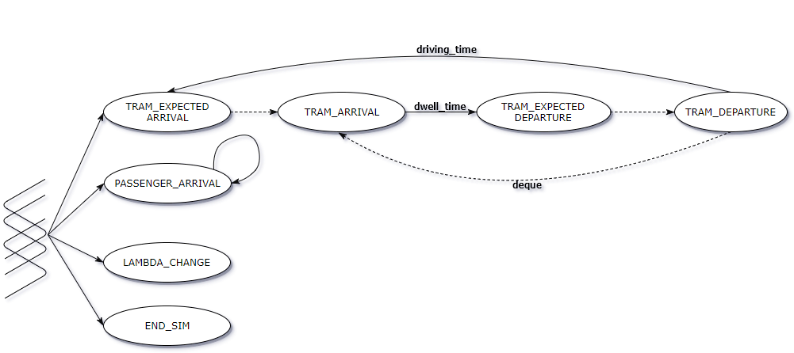
Problem description
Event graph:

Slide 6

Problem description
Performance Measures
Punctuality:
$departure delay=t_{actual}− t_{timetable}$
Passenger Waiting Times:
$waiting time=t_{boarding}− t_{arrival}$
Stop Congestion:
${congestion}_{avg}(stop)=\frac{\sum_{t∈T}{stop.capacity(t)}}{T}$

Slide 7
Input analysis
Data derived from the bus 12 route Fitting
Entering passengers
Poisson process, varies (λ) every 15 min.
Exponential distribution to model interarrival times.
Leaving passengers
Transformation into percentages
Beta distribution (a,b)
Data derived from Nieuwegein-tramline
Run-times
Gamma distribution

Slide 8
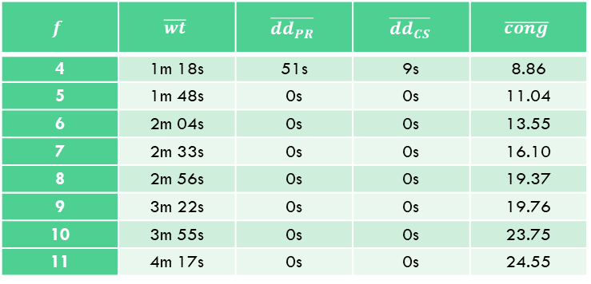
Output analysis
Questions answered by the experiments:
Feasible frequencies of the tram
$$f$$ | $$\overline{wt}$$ | $$\overline{dd_{PR}}$$ | $$\overline{dd_{CS}}$$ | $$\overline{cong}$$
4 | 1m 18s | 51s | 9s | 8.86
5 | 1m 48s | 0s | 0s | 11.04
6 | 2m 04s | 0s | 0s | 13.55
7 | 2m 33s | 0s | 0s | 16.10
8 | 2m 56s | 0s | 0s | 19.37
9 | 3m 22s | 0s | 0s | 19.76
10 | 3m 55s | 0s | 0s | 23.75
11 | 4m 17s | 0s | 0s | 24.55

Slide 9
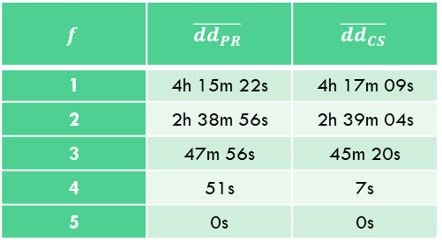
Output analysis
Questions answered by the experiments:
Measures to improve operational performance
$$f$$ | $$\overline{dd_{PR}}$$ | $$\overline{dd_{CS}}$$
1 | 4h 15m 22s | 4h 17m 09s
2 | 2h 38m 56s | 2h 39m 04s
3 | 47m 56s | 45m 20s
4 | 51s | 7s
5 | 0s | 0s

Slide 10
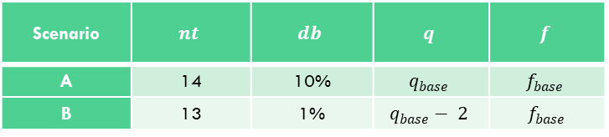
Output analysis
Scenarios:
Extra tram, 14 trams instead of 13
Better technology
Scenario | $$nt$$ | $$db$$ | $$q$$ | $$f$$
A | 14 | 10% | $$q_{base}$$ | $$f_{base}$$
B | 13 | 1% | $$q_{base}− 2$$ | $f_{base}$

Slide 11
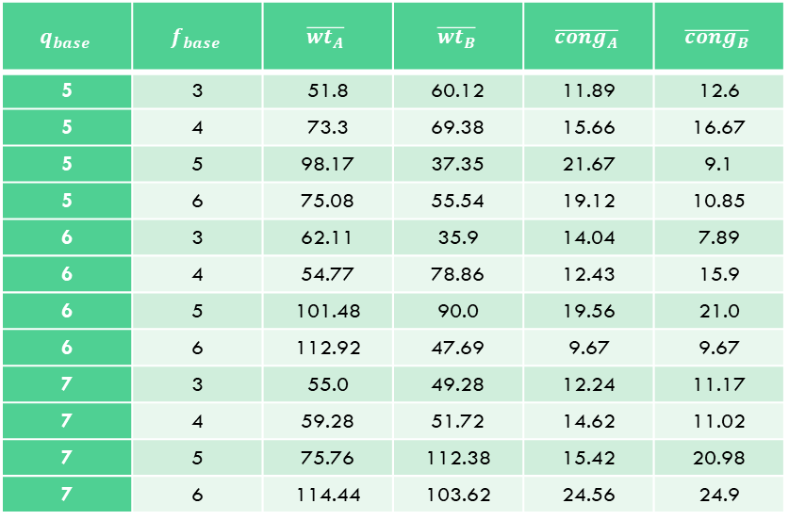
Output analysis
Scenarios Results:
During peak hours
$$q_{base}$$ | $$f_{base}$$ | $$\overline{wt_{A}}$$ | $$\overline{wt_{B}}$$ | $$\overline{cong_{A}}$$ | $$\overline{cong_{B}}$$
5 | 3 | 51.8 | 60.12 | 11.89 | 12.6
5 | 4 | 73.3 | 69.38 | 15.66 | 16.67
5 | 5 | 98.17 | 37.35 | 21.67 | 9.1
5 | 6 | 75.08 | 55.54 | 19.12 | 10.85
6 | 3 | 62.11 | 35.9 | 14.04 | 7.89
6 | 4 | 54.77 | 78.86 | 12.43 | 15.9
6 | 5 | 101.48 | 90.0 | 19.56 | 21.0
6 | 6 | 112.92 | 47.69 | 9.67 | 9.67
7 | 3 | 55.0 | 49.28 | 12.24 | 11.17
7 | 4 | 59.28 | 51.72 | 14.62 | 11.02
7 | 5 | 75.76 | 112.38 | 15.42 | 20.98
7 | 6 | 114.44 | 103.62 | 24.56 | 24.9

Slide 12
Output analysis
Scenarios Results:

Slide 13
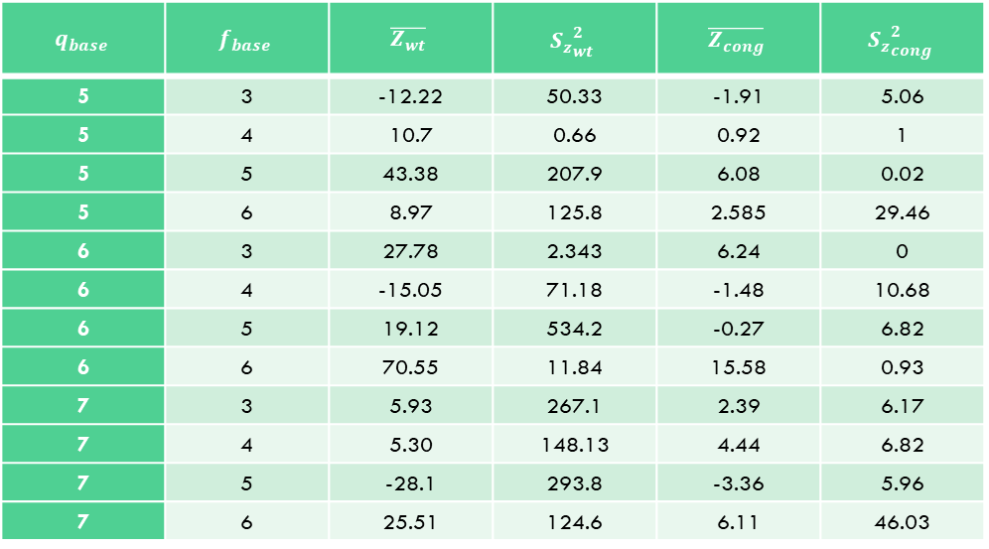
Output analysis
Scenarios Comparison:
Paired t-confidence intervals
a=0.05
df=30
$$q_{base}$$ | $$f_{base}$$ | $$\overline{Z_{wt}}$$ | $${S_{z}}_{wt}^{2}$$ | $$\overline{Z_{cong}}$$ | $${S_{z}}_{cong}^{2}$$
5 | 3 | -12.22 | 50.33 | -1.91 | 5.06
5 | 4 | 10.7 | 0.66 | 0.92 | 1
5 | 5 | 43.38 | 207.9 | 6.08 | 0.02
5 | 6 | 8.97 | 125.8 | 2.585 | 29.46
6 | 3 | 27.78 | 2.343 | 6.24 | 0
6 | 4 | -15.05 | 71.18 | -1.48 | 10.68
6 | 5 | 19.12 | 534.2 | -0.27 | 6.82
6 | 6 | 70.55 | 11.84 | 15.58 | 0.93
7 | 3 | 5.93 | 267.1 | 2.39 | 6.17
7 | 4 | 5.30 | 148.13 | 4.44 | 6.82
7 | 5 | -28.1 | 293.8 | -3.36 | 5.96
7 | 6 | 25.51 | 124.6 | 6.11 | 46.03

Slide 14
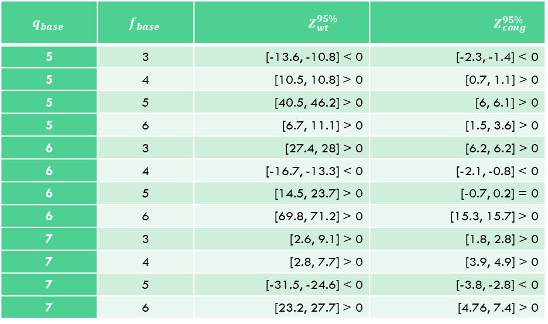
Output analysis
Scenarios Comparison:
Computed confidence intervals
$$q_{base}$$ | $$f_{base}$$ | $${ Z}_{wt}^{95\%}$$ | $Z_{cong}^{95\%}$
5 | 3 | [-13.6, -10.8] < 0 | [-2.3, -1.4] < 0
5 | 4 | [10.5, 10.8] > 0 | [0.7, 1.1] > 0
5 | 5 | [40.5, 46.2] > 0 | [6, 6.1] > 0
5 | 6 | [6.7, 11.1] > 0 | [1.5, 3.6] > 0
6 | 3 | [27.4, 28] > 0 | [6.2, 6.2] > 0
6 | 4 | [-16.7, -13.3] < 0 | [-2.1, -0.8] < 0
6 | 5 | [14.5, 23.7] > 0 | [-0.7, 0.2] = 0
6 | 6 | [69.8, 71.2] > 0 | [15.3, 15.7] > 0
7 | 3 | [2.6, 9.1] > 0 | [1.8, 2.8] > 0
7 | 4 | [2.8, 7.7] > 0 | [3.9, 4.9] > 0
7 | 5 | [-31.5, -24.6] < 0 | [-3.8, -2.8] < 0
7 | 6 | [23.2, 27.7] > 0 | [4.76, 7.4] > 0

Slide 15
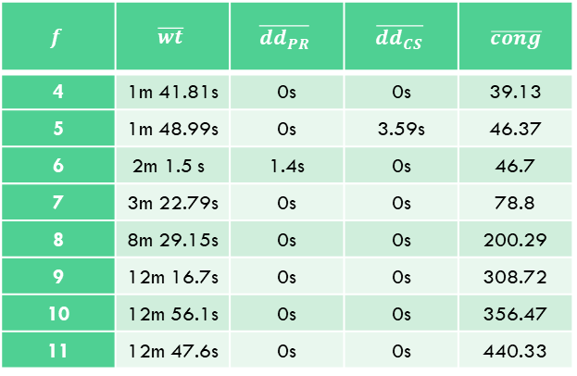
Validation
Artificial dataset results:
$$f$$ | $$\overline{wt}$$ | $$\overline{dd_{PR}}$$ | $$\overline{dd_{CS}}$$ | $\overline{cong}$
4 | 1m 41.81s | 0s | 0s | 39.13
5 | 1m 48.99s | 0s | 3.59s | 46.37
6 | 2m 1.5 s | 1.4s | 0s | 46.7
7 | 3m 22.79s | 0s | 0s | 78.8
8 | 8m 29.15s | 0s | 0s | 200.29
9 | 12m 16.7s | 0s | 0s | 308.72
10 | 12m 56.1s | 0s | 0s | 356.47
11 | 12m 47.6s | 0s | 0s | 440.33

